Slide 1
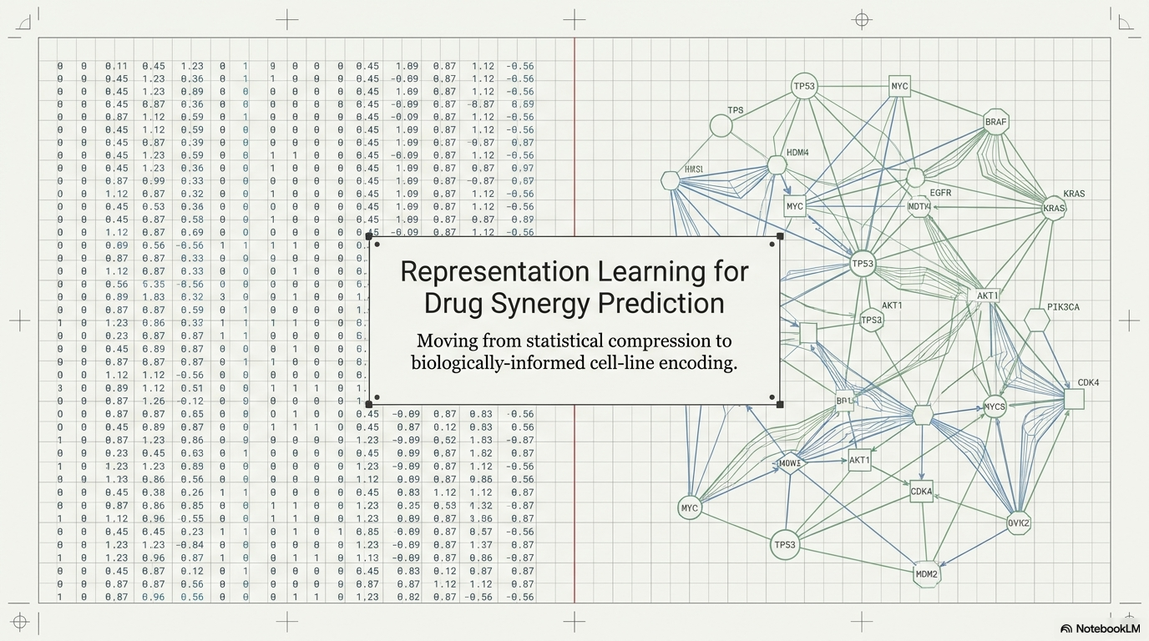

Slide 2
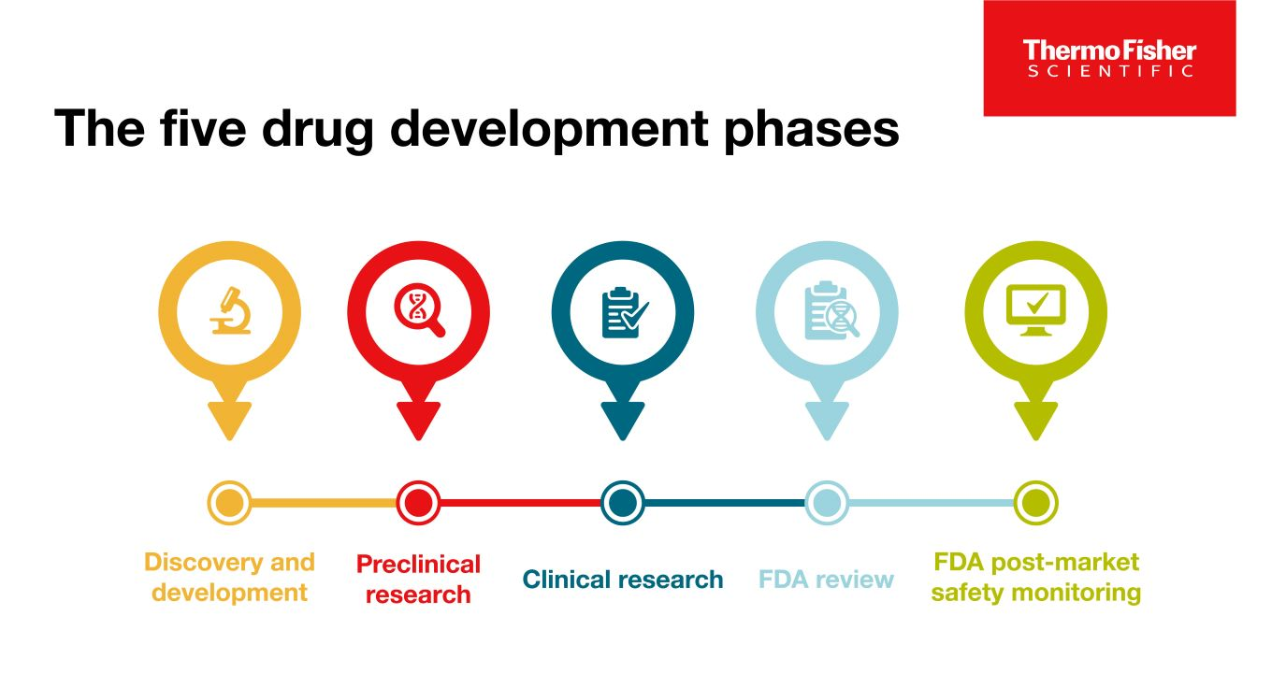

Slide 3
Therapeutics Data Commons (TDC)
DrugComb, NCI-60 (National Cancer Institute 60 cellines)
smiles_a | smiles_b | cell_line | target
CCCCCOC(=O)NC1=NC(=O)N(C=C1F)C2C(C(C(O2)C)O)O | CC1C(C(CC(O1)OC2CC(CC3=C2C(=C4C(=C3O)C(=O)C5=C(C4=O)C(=CC=C5)OC)O)(C(=O)CO)O)N)O.Cl | 786-0 | -2.6412059407483400
CCCCCOC(=O)NC1=NC(=O)N(C=C1F)C2C(C(C(O2)C)O)O | CC1C(C(CC(O1)OC2CC(CC3=C2C(=C4C(=C3O)C(=O)C5=C(C4=O)C(=CC=C5)OC)O)(C(=O)CO)O)N)O.Cl | A498 | -1.9062015723274300
CCCCCOC(=O)NC1=NC(=O)N(C=C1F)C2C(C(C(O2)C)O)O | CC1C(C(CC(O1)OC2CC(CC3=C2C(=C4C(=C3O)C(=O)C5=C(C4=O)C(=CC=C5)OC)O)(C(=O)CO)O)N)O.Cl | A549 | -1.3075159684751300
CCCCCOC(=O)NC1=NC(=O)N(C=C1F)C2C(C(C(O2)C)O)O | CC1C(C(CC(O1)OC2CC(CC3=C2C(=C4C(=C3O)C(=O)C5=C(C4=O)C(=CC=C5)OC)O)(C(=O)CO)O)N)O.Cl | ACHN | -4.307712681538250
Rows: 297,098
Presentation columns: 8
Cell lines: 59
Drug 1 identifiers: 127
Drug 2 identifiers: 126
Mean CSS: 23.13
ZIP synergy range: -36.01 to 66.66; mean -0.84
[array([0. , 0.057, 2.564, ..., 0. , 0. , 0. ]), array([4.662, 4.843, 5.301, ..., 5.432, 5.995, 5.492]), array([10. , 9.38, 7.73, 9.68, 7.08, 6.39, 6.75, 7.4 , 2.3 ,
10.69, 7.22, 11.19, 6.61, 6.81, 5.22, 5.53, 2.3 , 7.93,
2.3 , 12.78, 8.52, 7.46, 12.4 , 6.37, 12.07, 7.71, 10.47,
…,
2.3 , 2.3 , 2.3 , 2.3 , 2.3 , 5.5 , 5.24, 2.3 , 2.3 ,
5.63, 2.3 , 2.3 , 2.3 , 2.3 , 2.3 , 2.3 , 2.3 , 2.3 ,
7.65, 5.93, 9.52, 9.96, 2.3 , 2.3 ])]

Slide 4
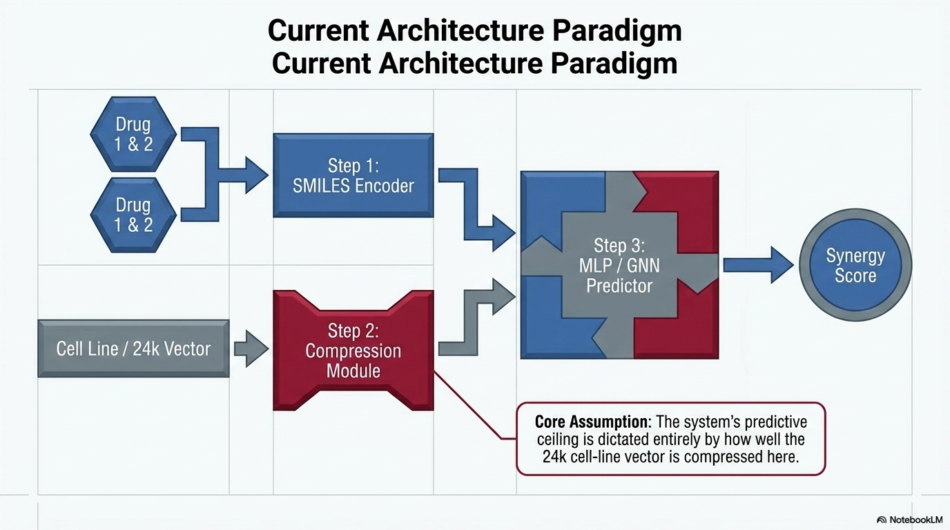

Slide 5
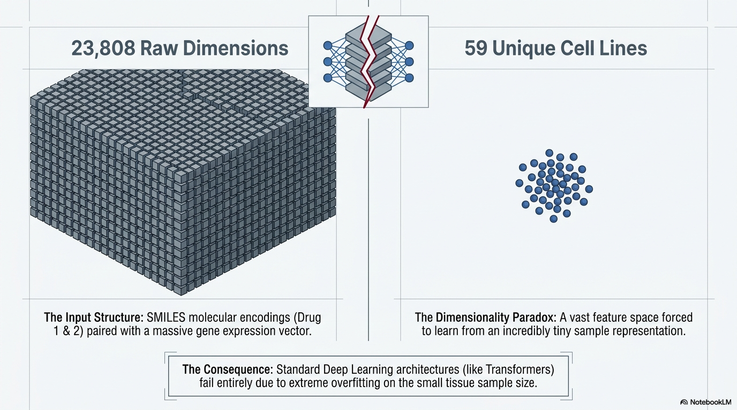
 | Test MSE
With ~23k celline genes | 29.051481
With ~3k celline genes | 29.046721
Without celline genes | 20.250234

Slide 6
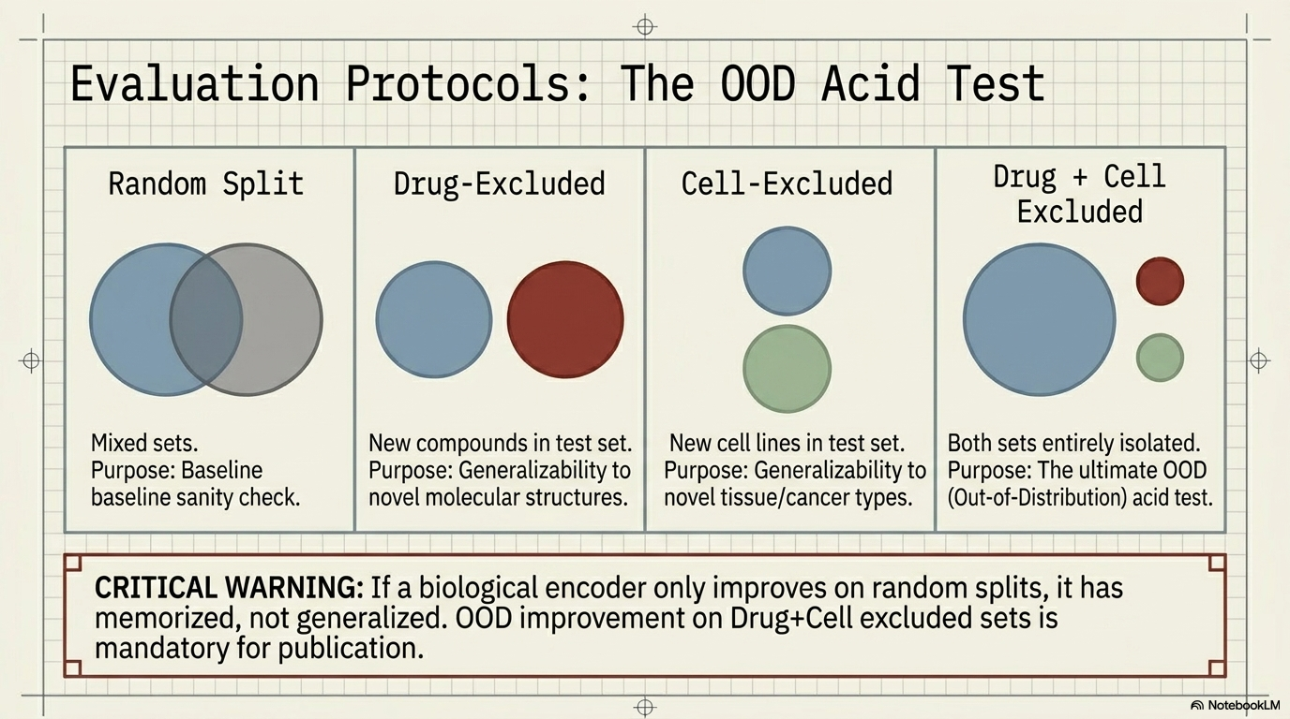
Data compression pipeline: raw `CellLine[0]` = `23808` dimensions -> keep top `3000` highest variance -> z-score -> PCA -> 128 dim vector
model_id | random_test_mse | random_test_pearson | drug_test_mse | drug_test_pearson | cell_line_test_mse | cell_line_test_pearson | drug_and_cell_line_test_mse | drug_and_cell_line_test_pearson | cv10_10k_mse
no_genes | 20.25023415772610 | 0.550455310509516 | 27.907377997214800 | 0.031646965345391300 | 21.87033367622750 | 0.5614096728707320 | 24.71524943681120 | 0.3799996050072120 | 16.908253549746100
pca128 | 19.04190770111340 | 0.5892189943581720 | 25.092786396312200 | 0.12393760151724000 | 36.02842263172420 | 0.40941038112578200 | 31.99514963363820 | 0.30315479396561500 | 14.92367250878630
cell_line col → Celline exclusion from test. Drug col → Drug exclusion from test. Random → no exclusion. Random splits

Slide 7
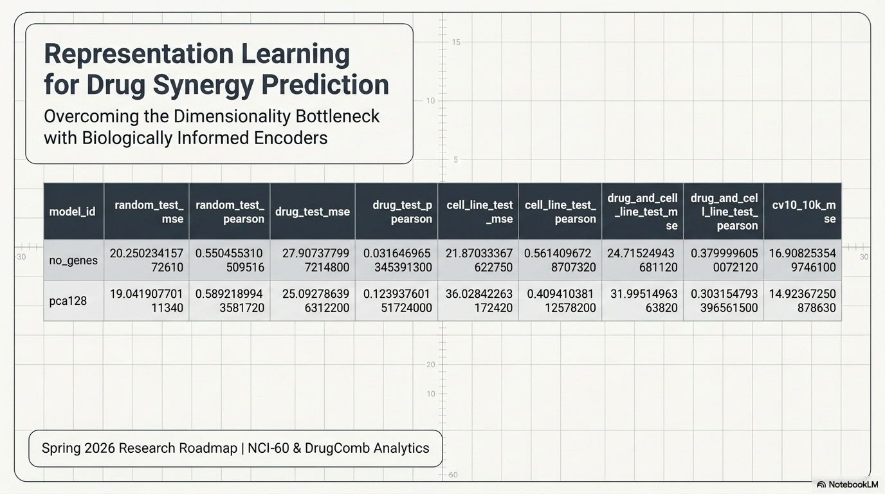

Slide 8
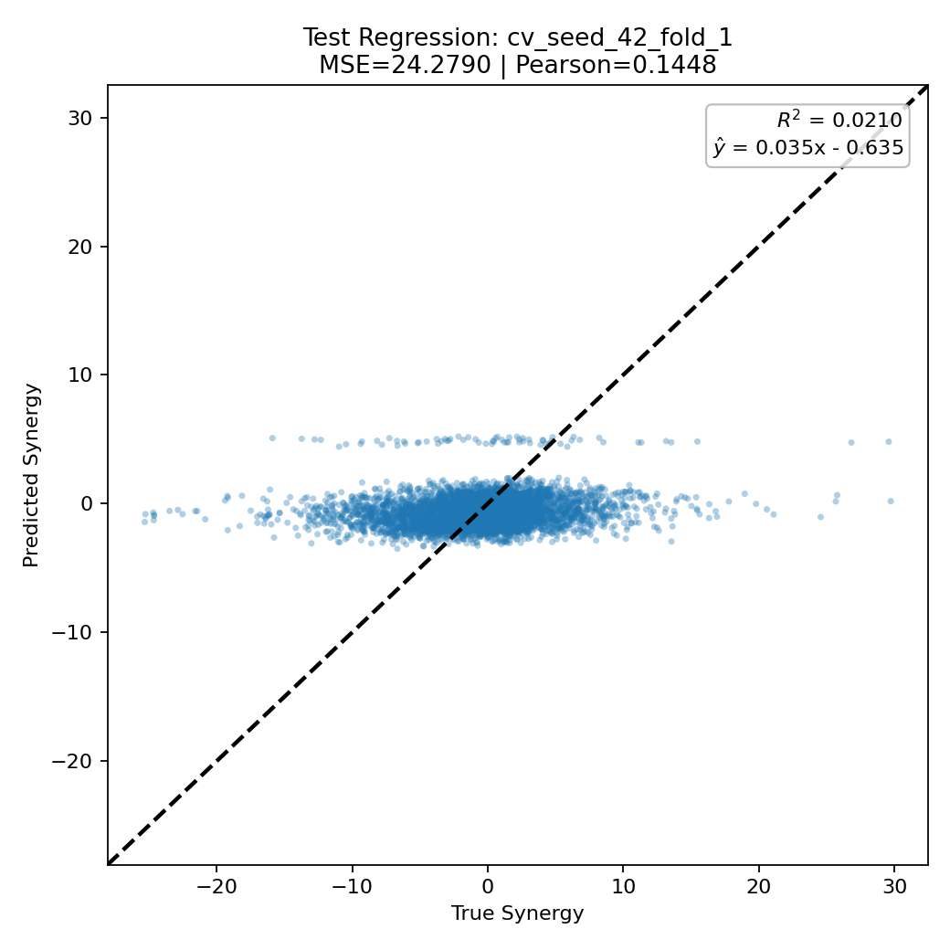
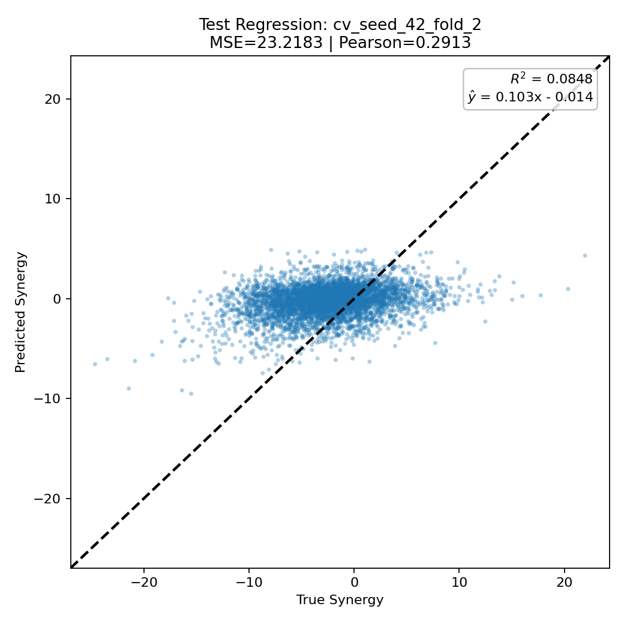
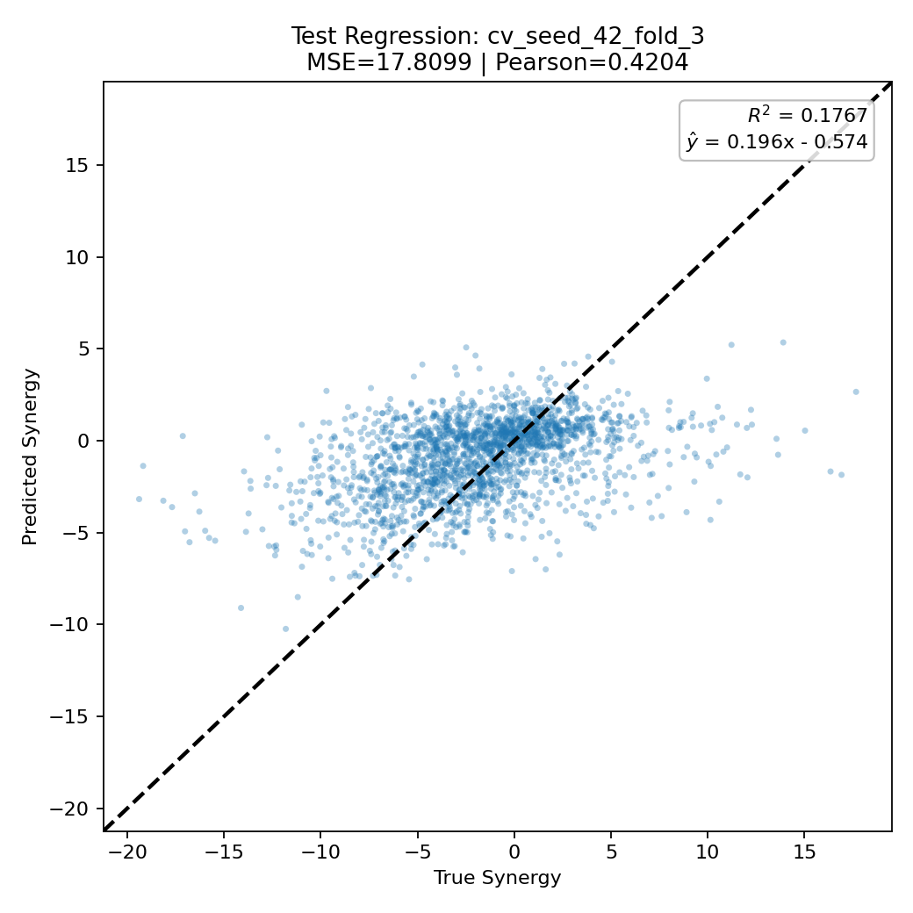
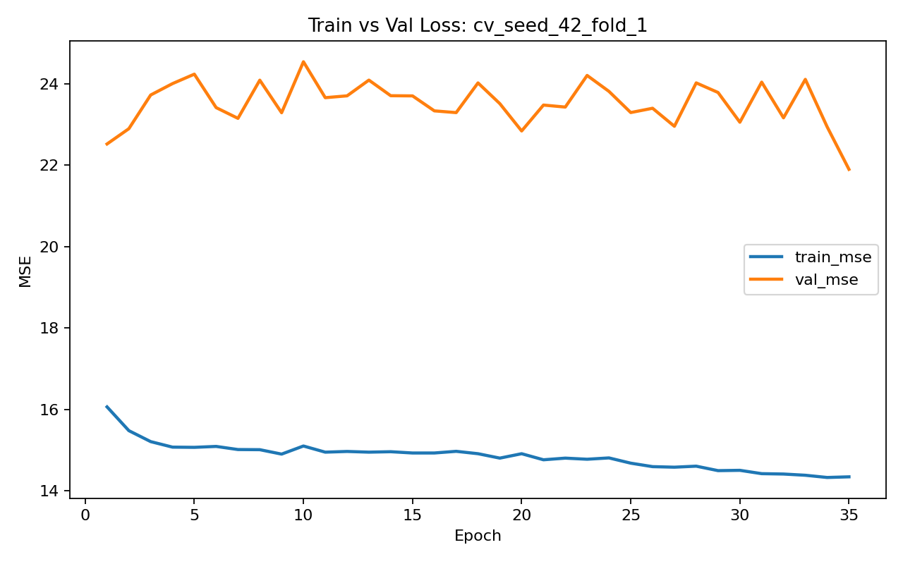
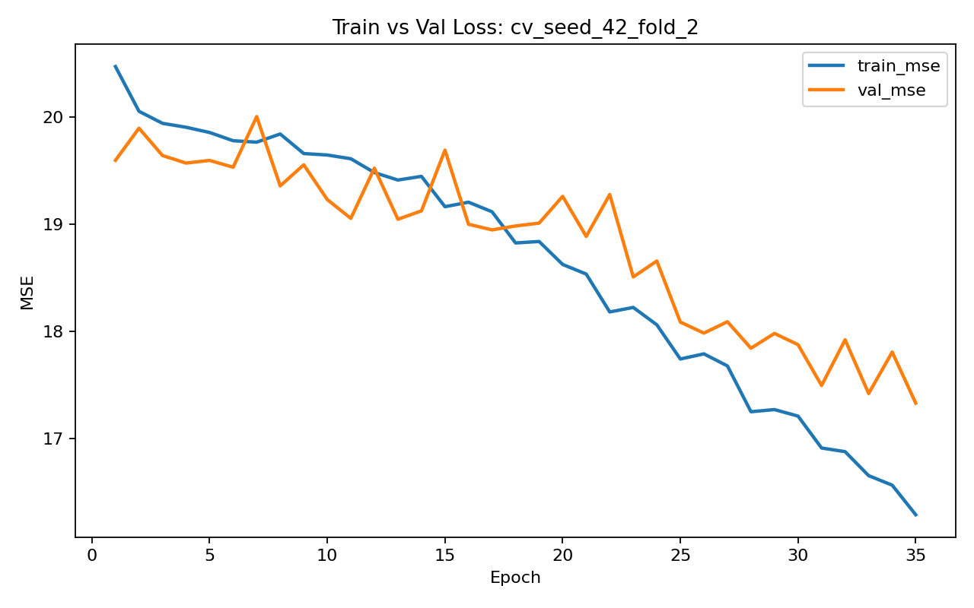
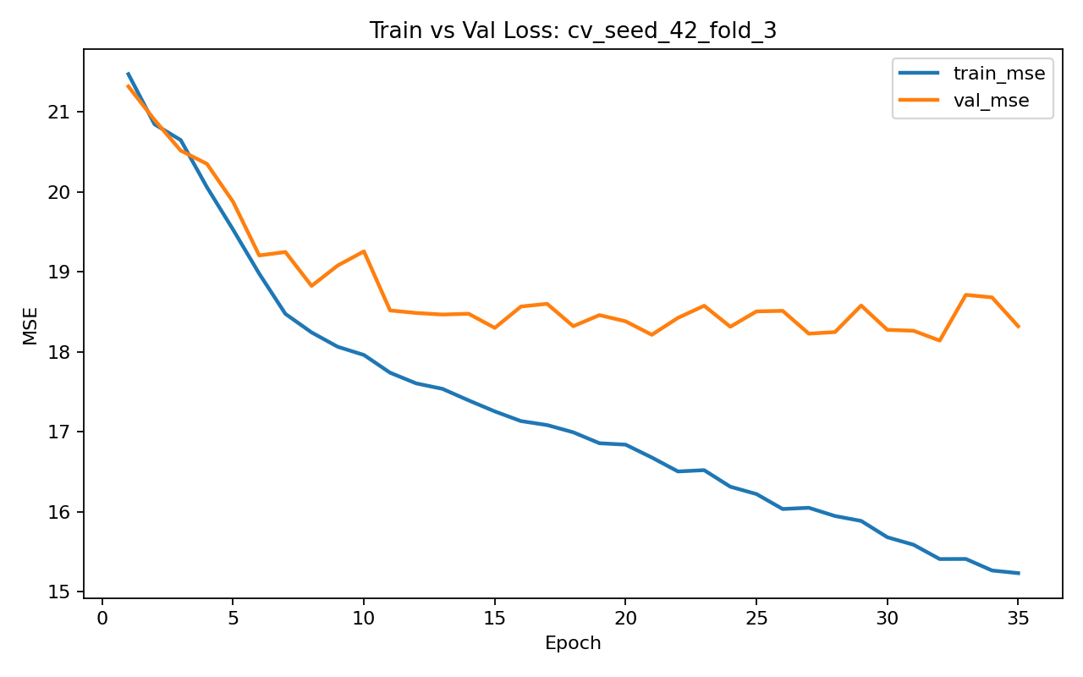

Slide 9
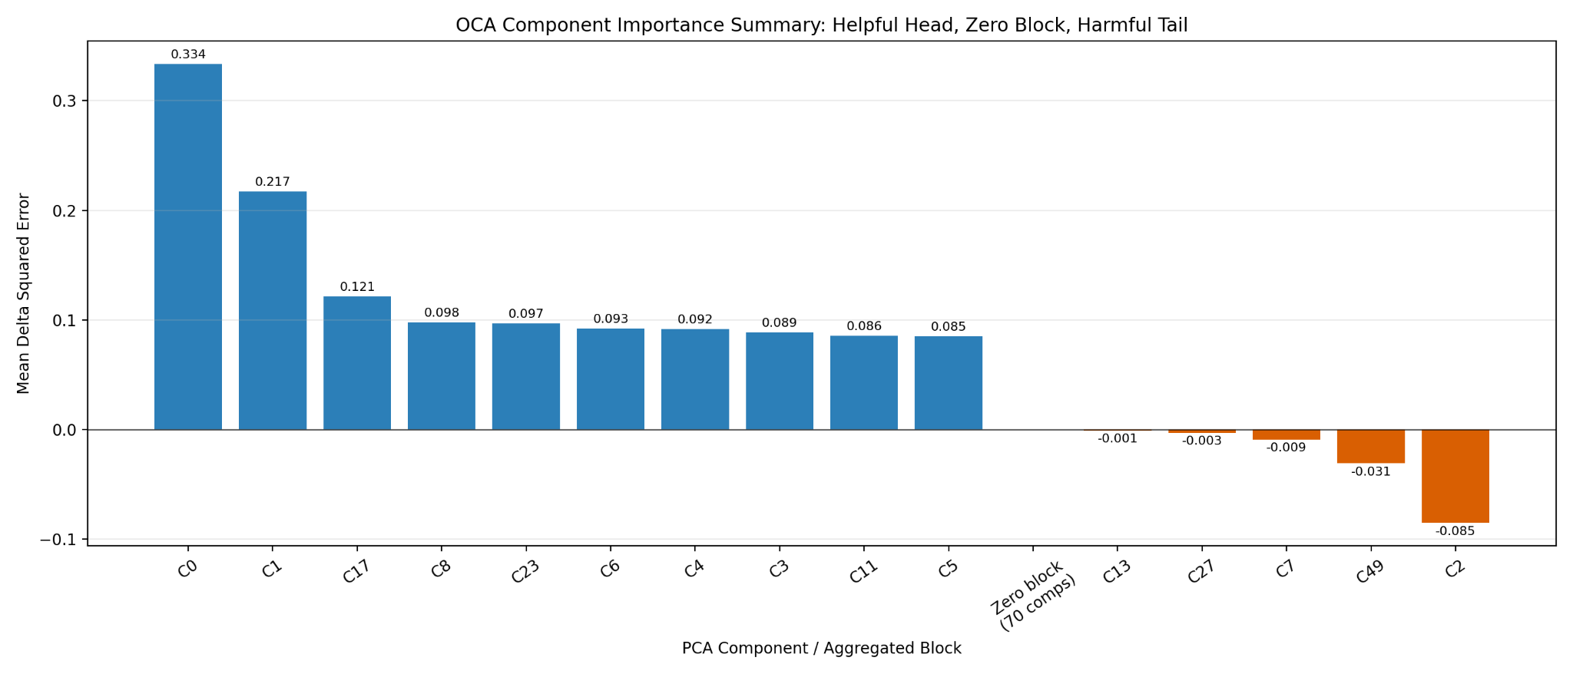
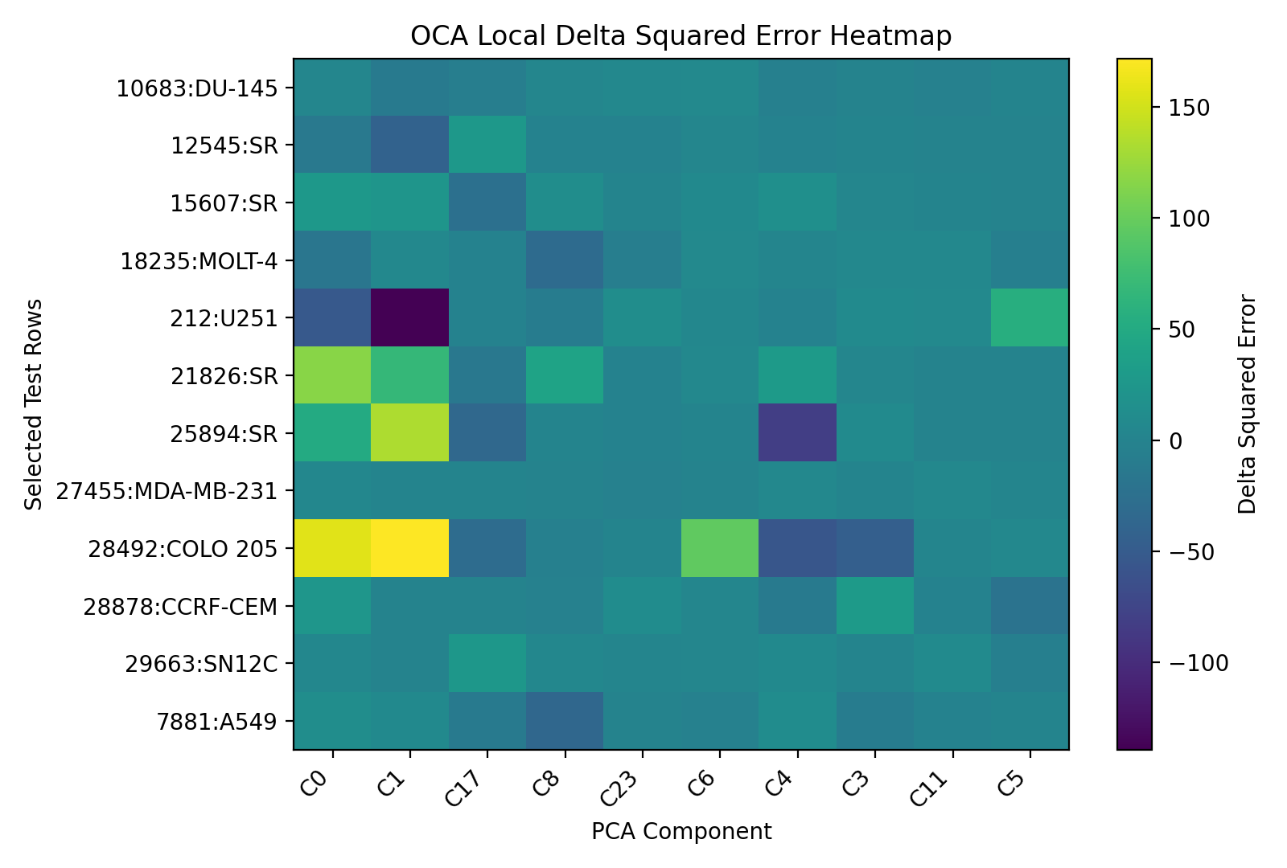

Slide 10
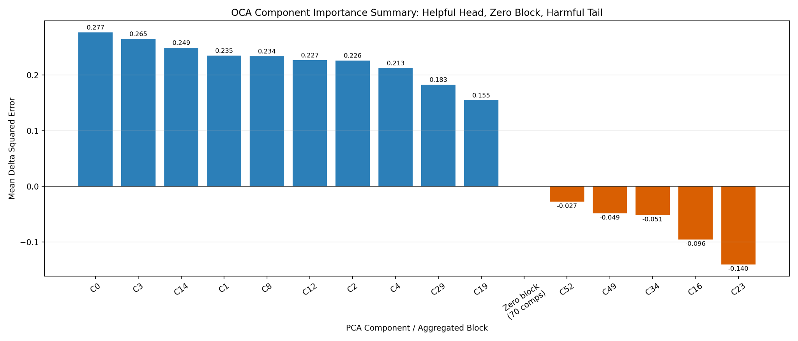
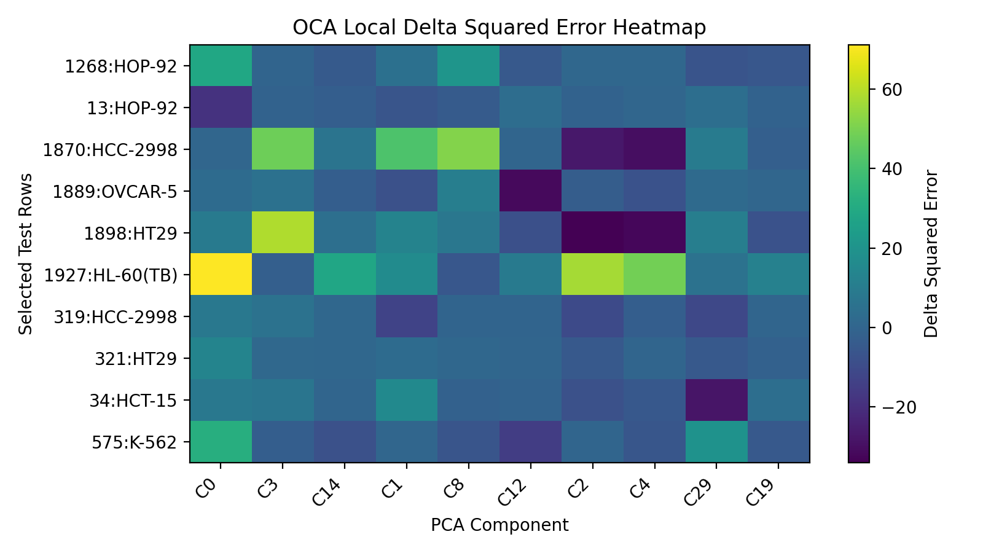
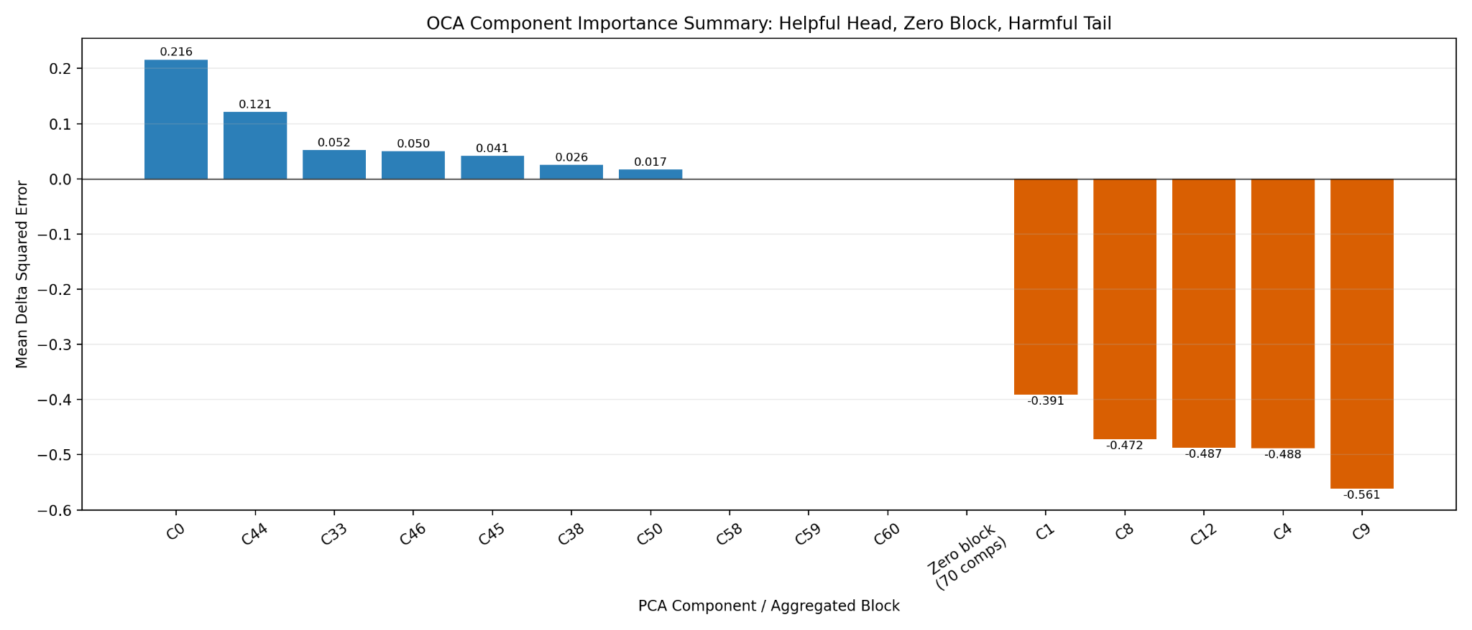
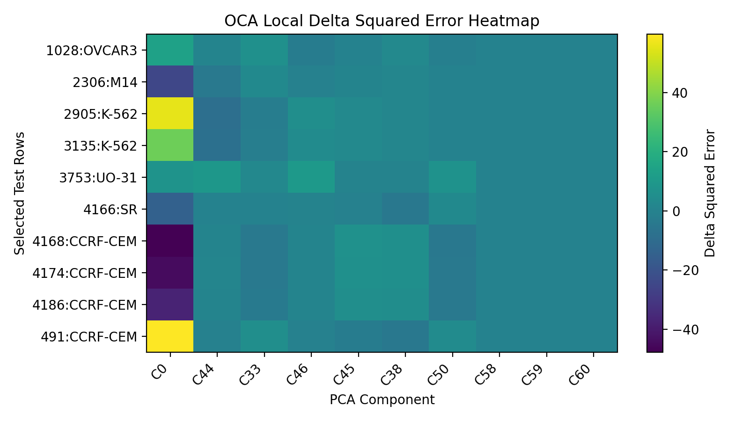

Slide 11
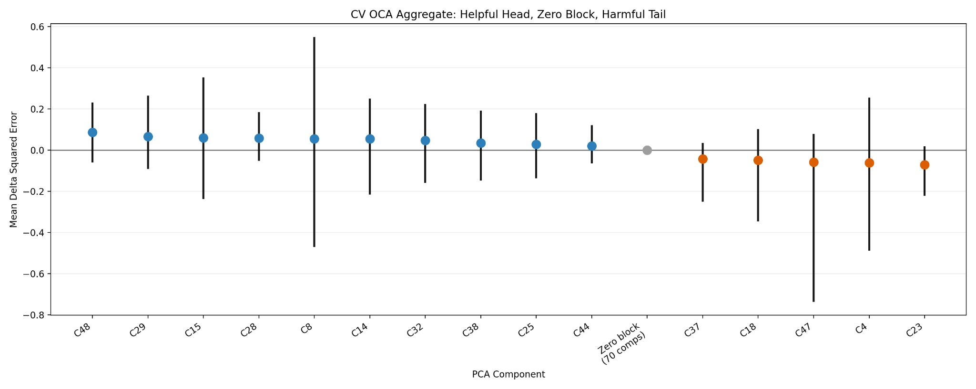

Slide 12
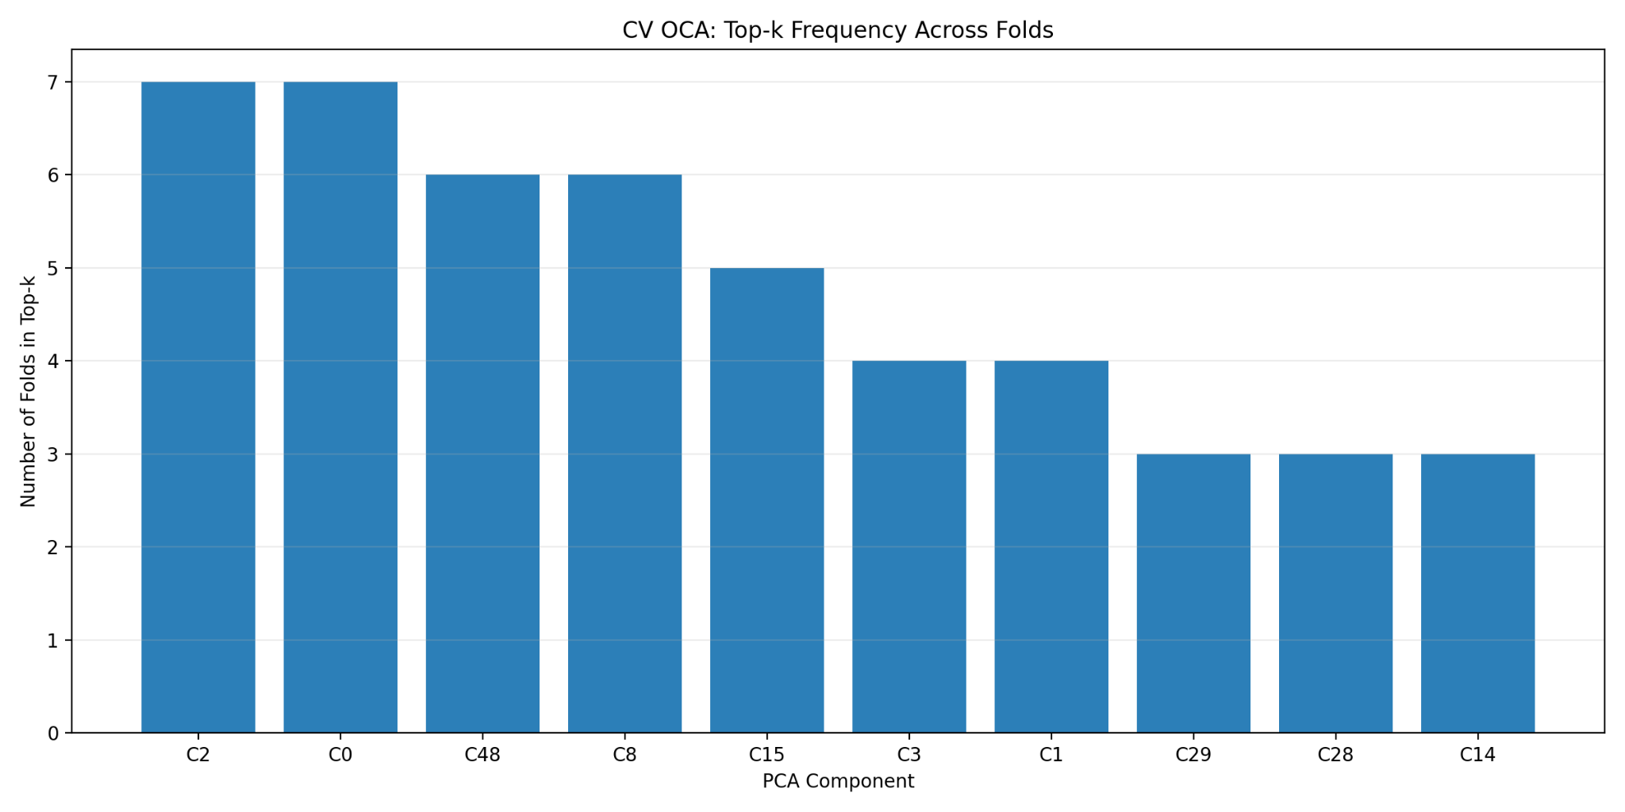
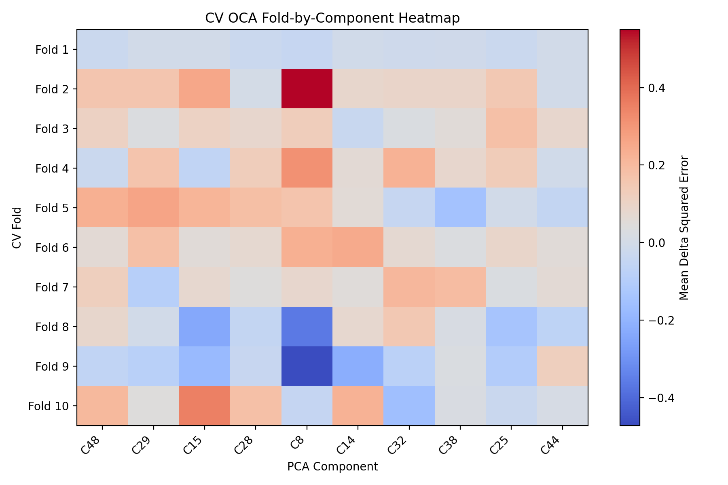

Slide 13
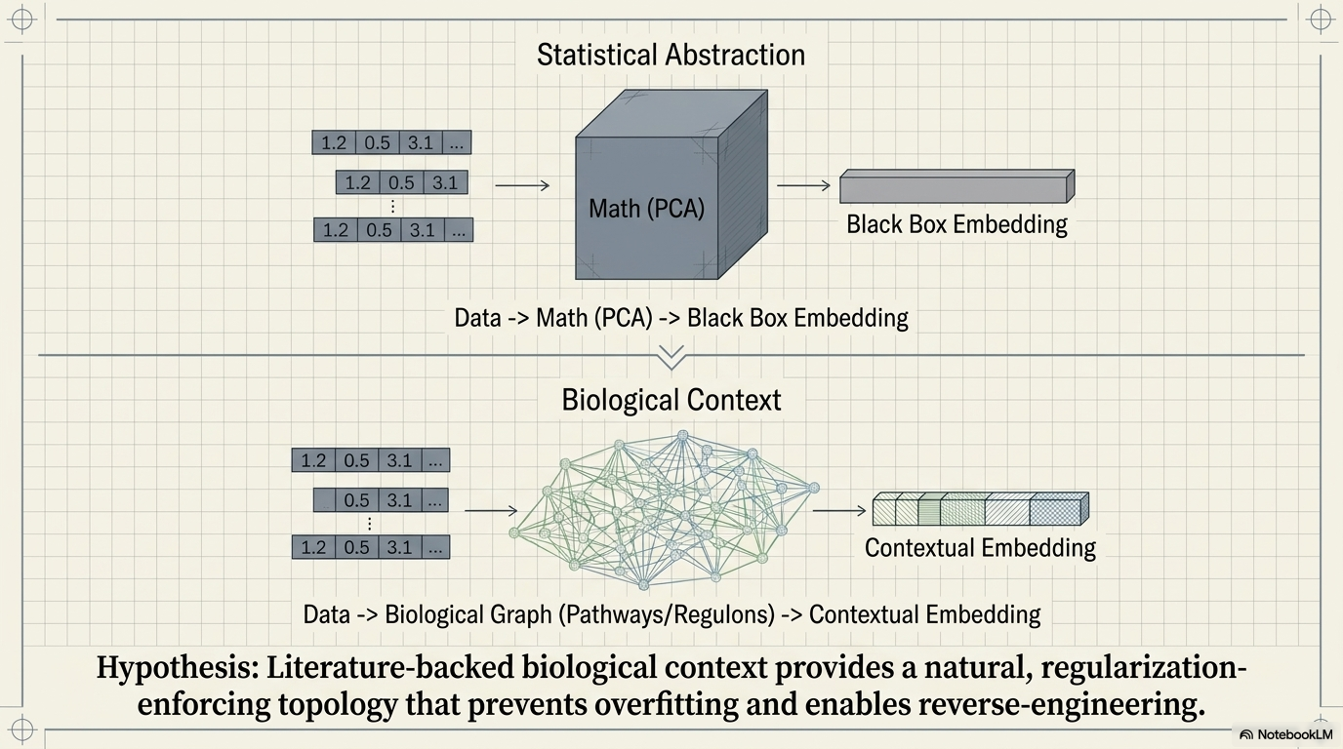

Slide 14
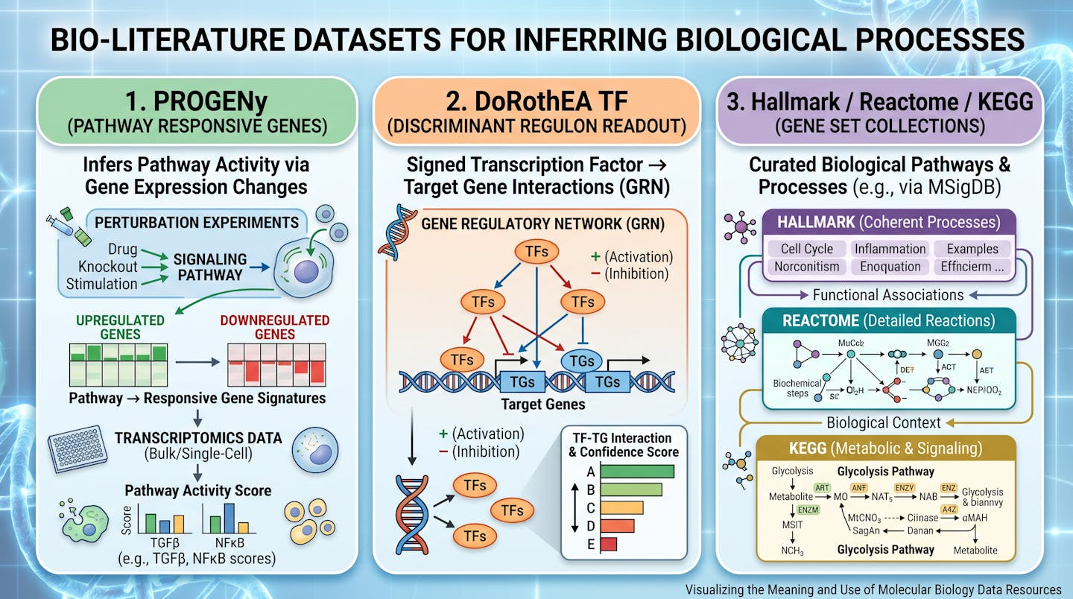

Slide 15
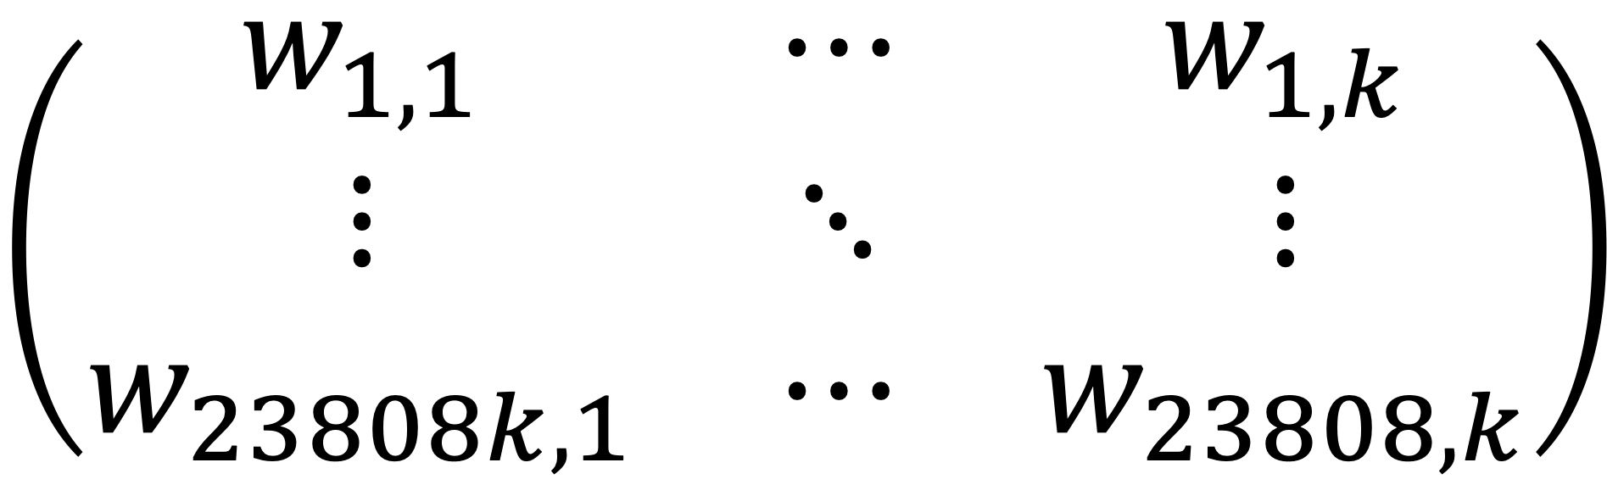
Number of bio-programs
$$\left(\begin{matrix}w_{1,1} & ⋯ & w_{1,k} \\ ⋮ & ⋱ & ⋮ \\ w_{23808k,1} & ⋯ & w_{23808,k}\end{matrix}\right)$$
Number of celline
genes
M

Slide 16
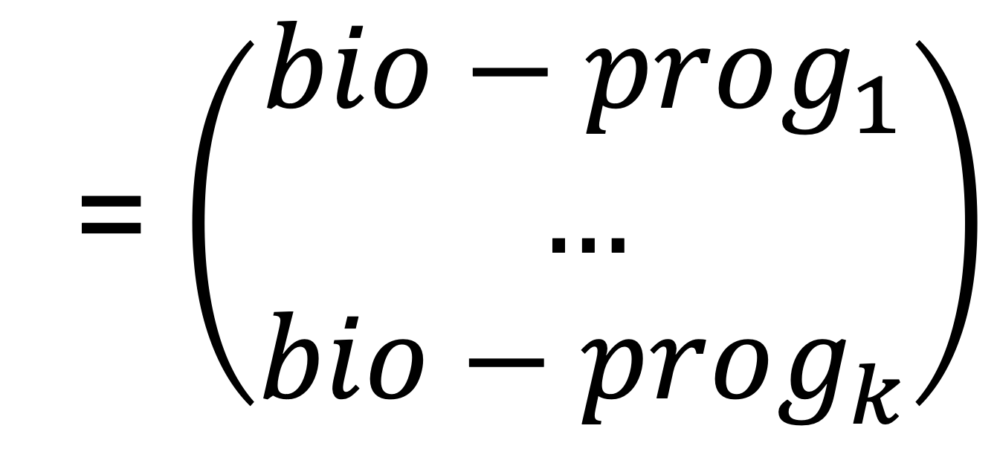
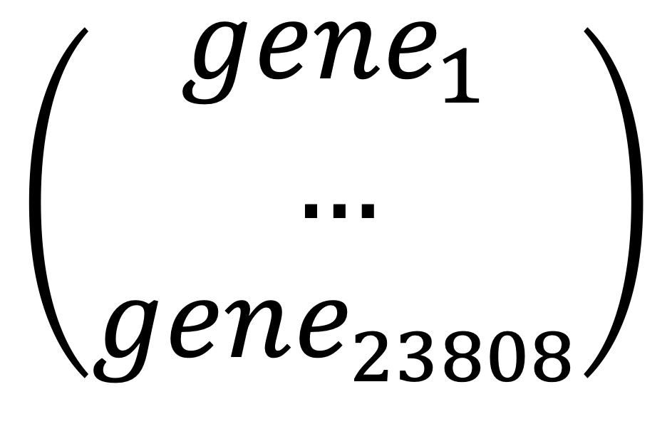
$$\left(\begin{matrix}gene_{1} \\ … \\ gene_{23808}\end{matrix}\right)$$
M
= $\left(\begin{matrix}bio−prog_{1} \\ … \\ bio−prog_{k}\end{matrix}\right)$

Slide 17
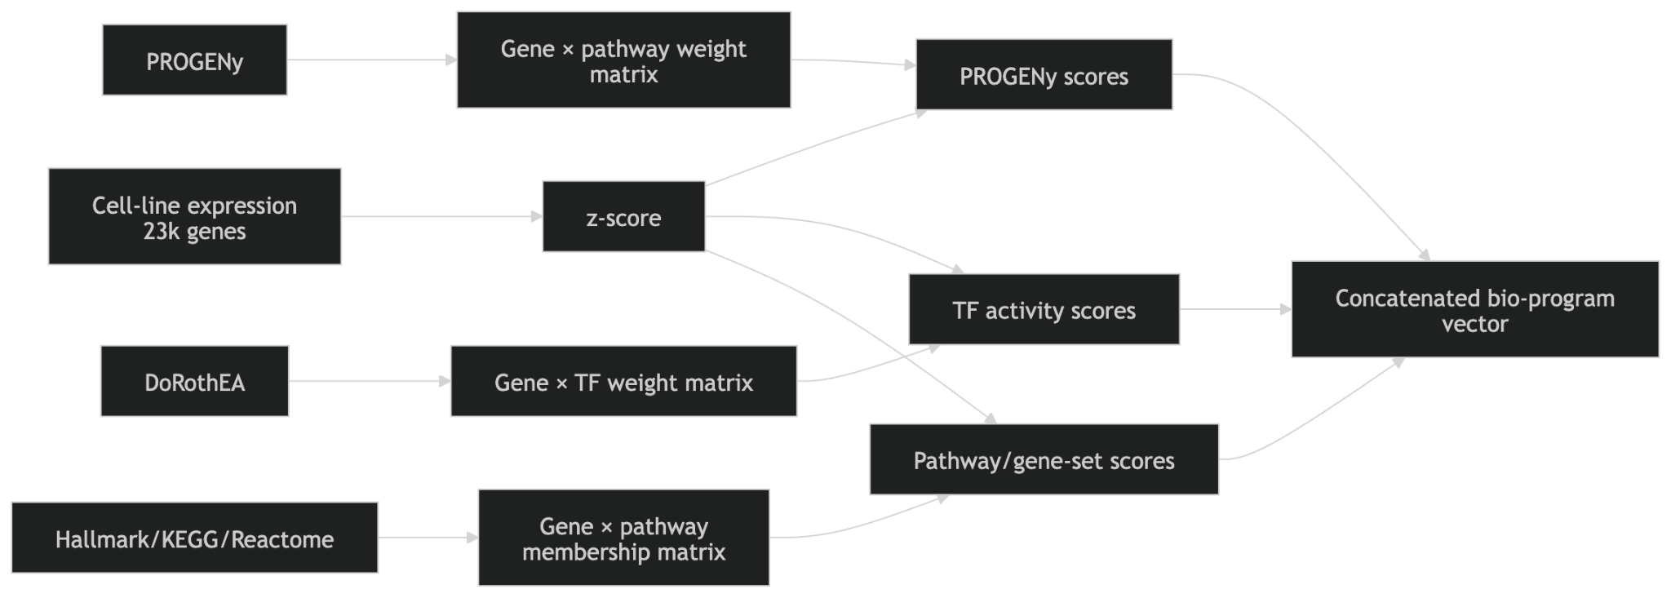

Slide 18
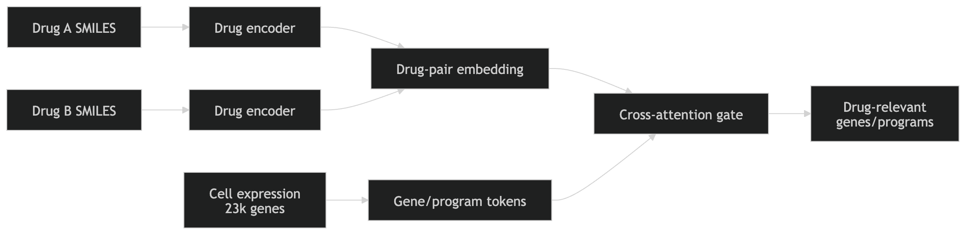

Slide 19
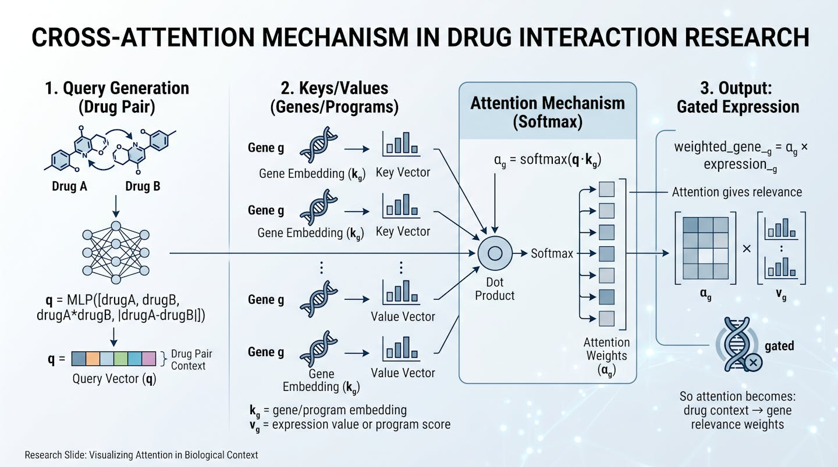
Molecules and transformers

Slide 20
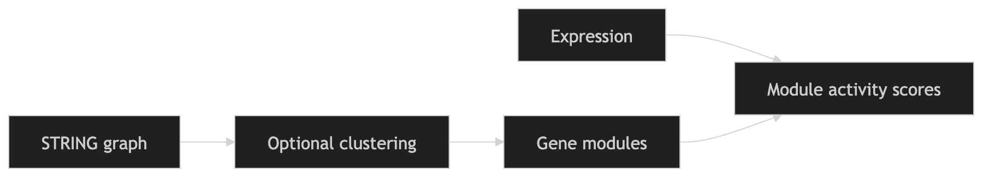

Slide 21
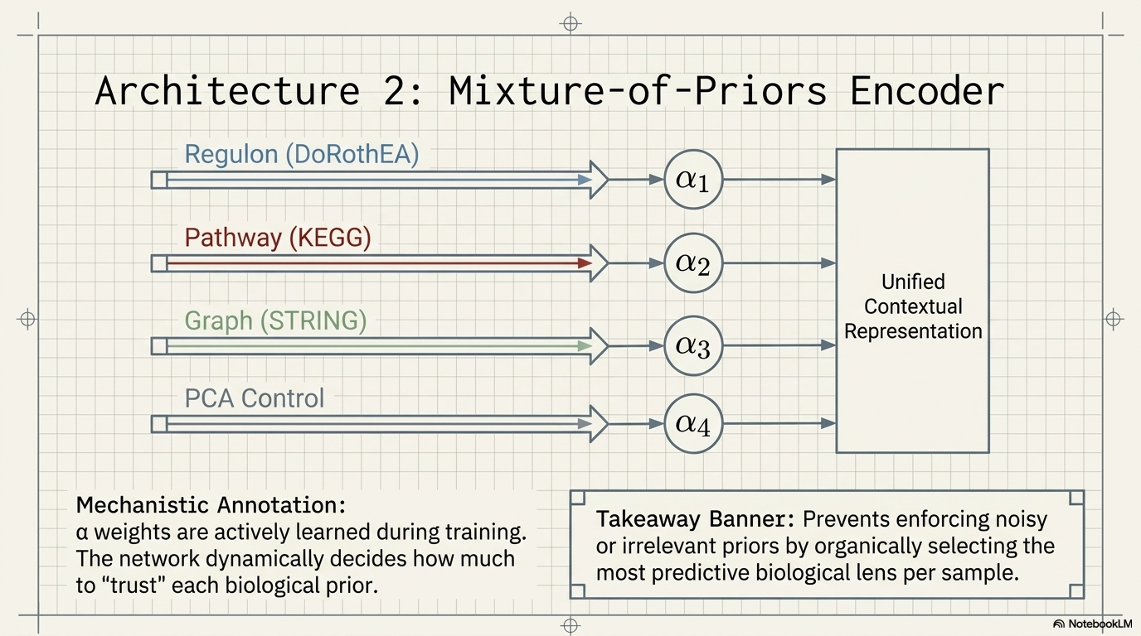

Slide 22
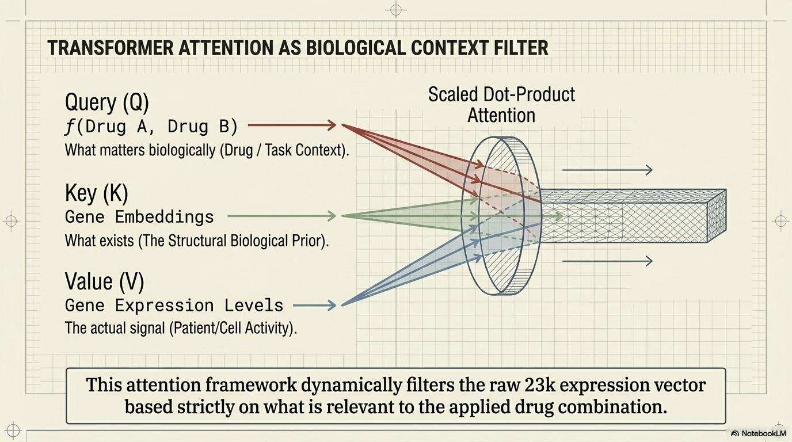

Slide 23
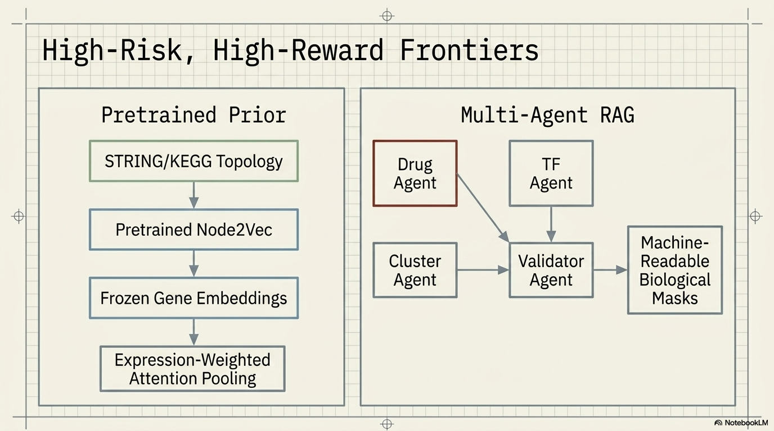

Slide 24
DeepSynergy, baseline for the current MLP-based synergy predictor
Preuer, K., Lewis, R. P. I., Hochreiter, S., Bender, A., Bulusu, K. C., and Klambauer, G. DeepSynergy: predicting anti-cancer drug synergy with Deep Learning.
https://academic.oup.com/bioinformatics/article/34/9/1538/4747884
https://www.bioinf.jku.at/software/DeepSynergy/
SOTA model Diagram
https://ars.els-cdn.com/content/image/1-s2.0-S1476927125003974-ga1_lrg.jpg
https://www.sciencedirect.com/science/article/abs/pii/S1476927125003974
https://academic.oup.com/bioinformatics/article/34/8/1433/4657075
Main reference implementation used to understand a stronger drug-synergy pipeline and where gene expression enters the model
Kuru, H. I., Tastan, O., and Cicek, A. E. MatchMaker: A Deep Learning Framework for Drug Synergy Prediction.
DrugComb
Zagidullin, B. et al. DrugComb: an integrative cancer drug combination data portal.
Baseline for autoencoder-style compression of high-dimensional omics features before synergy prediction
AuDNNsynergy.
Relevant next-stage references (network-informed or biologically structured encoders for gene-expression data)
PRODeepSyn and TranSynergy
Large models might overfit (GNNs, LLMs)
https://www.nature.com/articles/s41467-017-02391-6?utm_source=chatgpt.com shows why something like regulon might be better
https://pmc.ncbi.nlm.nih.gov/articles/PMC12753315/ - why big models fail
ttps://www.nature.com/articles/s41698-024-00589-8 - Birefly mention their big models failed, and they used GNNs, but also used biological context (rely on multi-omics data ?)
this is an obstacle we had to overcome
Transctiption networks
https://string-db.org/cgi/download?sessionId=bXpoT6tV8LHu
Metabolic pathways
https://www.kegg.jp/pathway/map01100

